Slide 1

Spy game
Imagine you’re a spy and you want to track someone. You have smart computer hackers helping you.
What would you tell them to do if you really wanted to know about a person? Where would you tell them to look? What information could you use to find out more about the person?

Slide 2
Surveillance
when we are being watched

Slide 3
Surveillance
To surveil is to look at what a person is doing without them knowing it.
Governments use surveillance to keep their citizens safe.
They can collect our internet browsing history, read e-mail and Facebook-profiles, listen to our phones, check surveillance cameras that see us in the streets and so on.
What do you know about surveillance?

Slide 4
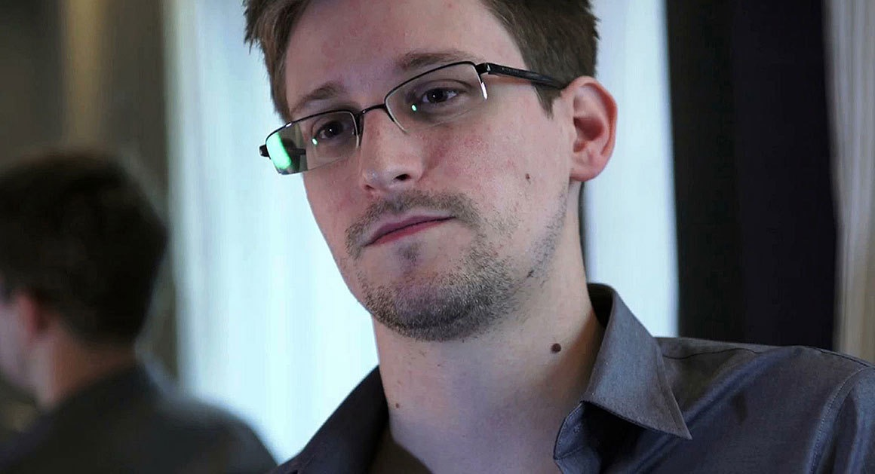
Who is this?
Notes:
Why is he famous?
He leaked documents showing how the american government was surveilling and monitoring the American people (and the rest of the world) on the internet.
NB! Make sure you point out how surveillance is hard and complicated to understand. We can ”know” what it is intuitively, but it’s hard to figure out how to process something that vast and complicated. This is the point of the upcoming video clip.

Slide 5
Before you watch…
What is Snowden and Oliver trying to tell us about surveillance?
What does Snowden think America has to do?
Notes:
Land in, weighing the pros and cons.

Slide 6
https://www.youtube.com/watch?v=XEVlyP4_11M&feature=youtu.be&t=1470

Slide 7
arguments
An argument is often a reason to do something or a reason something is true
We should raise the temperature in the school, because the students are cold.
Snakes are dangerous, because my uncle died when a snake bit him

Slide 8
counterarguments
Counterarguments are reasons NOT to do something or a reason something is false.
We should not raise the temperature in the school, because it would be expensive.
Snakes are not dangerous, because most snakes don’t have venom that can harm people.

Slide 9
Argument Practice
In 1 minute, write down as many arguments as you can FOR:
school uniforms
Socrative!
Now write down all the COUNTERARGUMENTS for school uniforms you can in 1 minute!
Socrative!

Slide 10
A debate
A debate is when you compare arguments and counterarguments
A debate is not about shouting and winning
A debate should look at the all arguments and decide which are the best ones

Slide 11
Debate teams
Padlet link | TEAM PRIVACY | TEAM SURVEILLANCE
tiny.cc/arguing1 | Team 1 | Team 3
tiny.cc/arguing2 | Team 2 | Team 4

Slide 12
Debate instructions
Take your time, keep the Padlet clean and tidy.
1. Write down all the arguments FOR your cause. Research on the internet if you need to. 10 minutes.
2. Write down all the arguments AGAINST your cause. Research on the internet if you need to. 10 minutes.

Slide 13
Evaluating the arguments
Speak with your opposing team about the arguments and try to decide:
A. Which are the best arguments and counterarguments?
B. Which are the worst?
C. What does your group think about the issue? Are you for or against surveillance?
If you finish, have a look at the other group’s arguments and try to evaluate them too (tiny.cc/arguing1, tiny.cc/arguing2)

